Slide 1
Caffeine Productivity & Rest Analysis
Group Better Buzz: Cooper Jumamil, Havanna Robbins, Haylee Marks-Mitchell, June Phillips

Slide 2
Table of Contents
Introduction
Data Sourcing & Processing
Exploratory Data Analysis
Modeling & Analysis
Discussion & Conclusion

Slide 3
Introduction

Slide 4
Background
Lots of people rely on caffeine via coffee, tea, or energy drinks on a daily basis to:
  Stay awake
  Study fuel
  Get through long days
It is not always clear how each type of caffeinated beverage actually affects:
  Focus during the day
  Sleep quality at night
We wanted to look at the data and see how caffeine truly affects people

Slide 5
Research Questions
1.
3.
Does the type of caffeinated beverage (coffee, tea, or energy drink) affect focus levels?
How do other factors like caffeine amount and time of day interact with beverage type when it comes to focus and sleep?
2.
4.
Does beverage type affect sleep outcomes, including sleep quality and whether sleep was negatively impacted?
(Stretch goal) Can we build a simple predictive model to estimate the probability that a person’s sleep will be impacted, based on their caffeine intake pattern?

Slide 6
Hypothesis
Coffee and energy drinks will have higher focus levels on average, but will have a negative impact on sleep and sleep quality as opposed to tea.
More specifically, we expect:
  Focus: Coffee and energy drink drinkers will report higher focus_level than tea drinkers.
  Sleep quality: Tea drinkers will have higher average sleep_quality scores.
  Sleep impact: Coffee and especially energy drinks will show higher rates of sleep_impacted = 1 than tea.

Slide 7
Data
Sourcing & Processing

Slide 8
Data Set
Found on Kaggle
“Caffeine Intake Tracker”
Collected by Preksha Dewoolkar
500 observations, 13 features
Data collected through a comprehensive survey study involving 500 participants who tracked their caffeine consumption patterns and subsequent effects
Data represents a snapshot of caffeine consumption habits:
  impact on focus and sleep quality
  Collected through standardized self-reporting methods

Slide 9
Data Columns
sleep_quality
caffeine_mg
Self-reported sleep quality on a 0–1 scale
Amount of caffeine consumed (normalized)
sleep_impact
age
Binary flag (1 = sleep was negatively impacted, 0 = no impact)
Age of the participant (normalized)
beverage_coffee, beverage_tea, beverage_energy_drink
focus_level
Self-reported focus level on a 0–1 scale
One-hot encoded beverage type
time_of_day_morning, time_of_day_afternoon, time_of_day_evening
gender_female, gender_male
One-hot encoded gender variables
When the person consumed caffeine

Slide 10
Data Processing
Loaded dataset using Pandas
Check for:
Combined Coffee, Tea, Energy Drink:
beverage_type
Verified distributions and normalized numerical fields when necessary
Prepared features for modeling:
no missing values and correct data types
caffeine_mg, age, one-hot beverage and time-of-day variables. gender indicators

Slide 11
Exploratory
Data Analysis

Slide 12
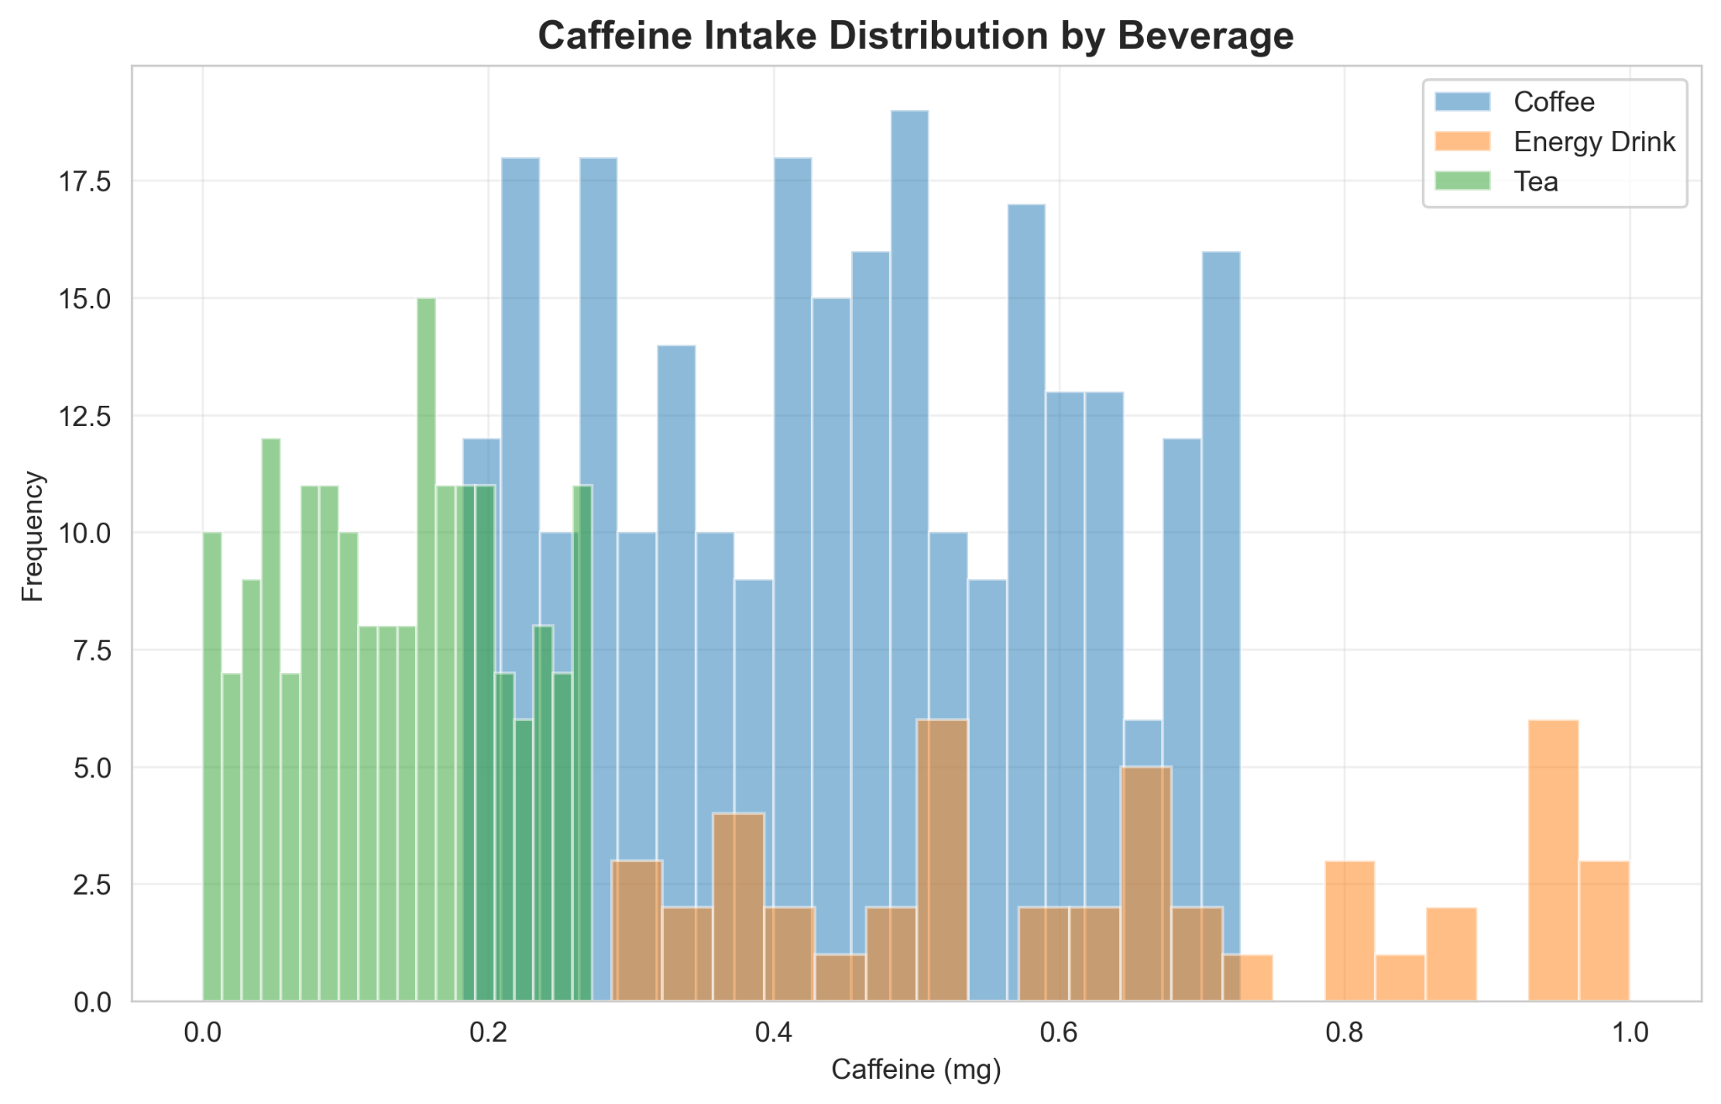
Caffeine Intake Distribution by Beverage
Bar chart
X axis = Caffeine (in milligrams)
Y axis = Frequency of consumption

Slide 13
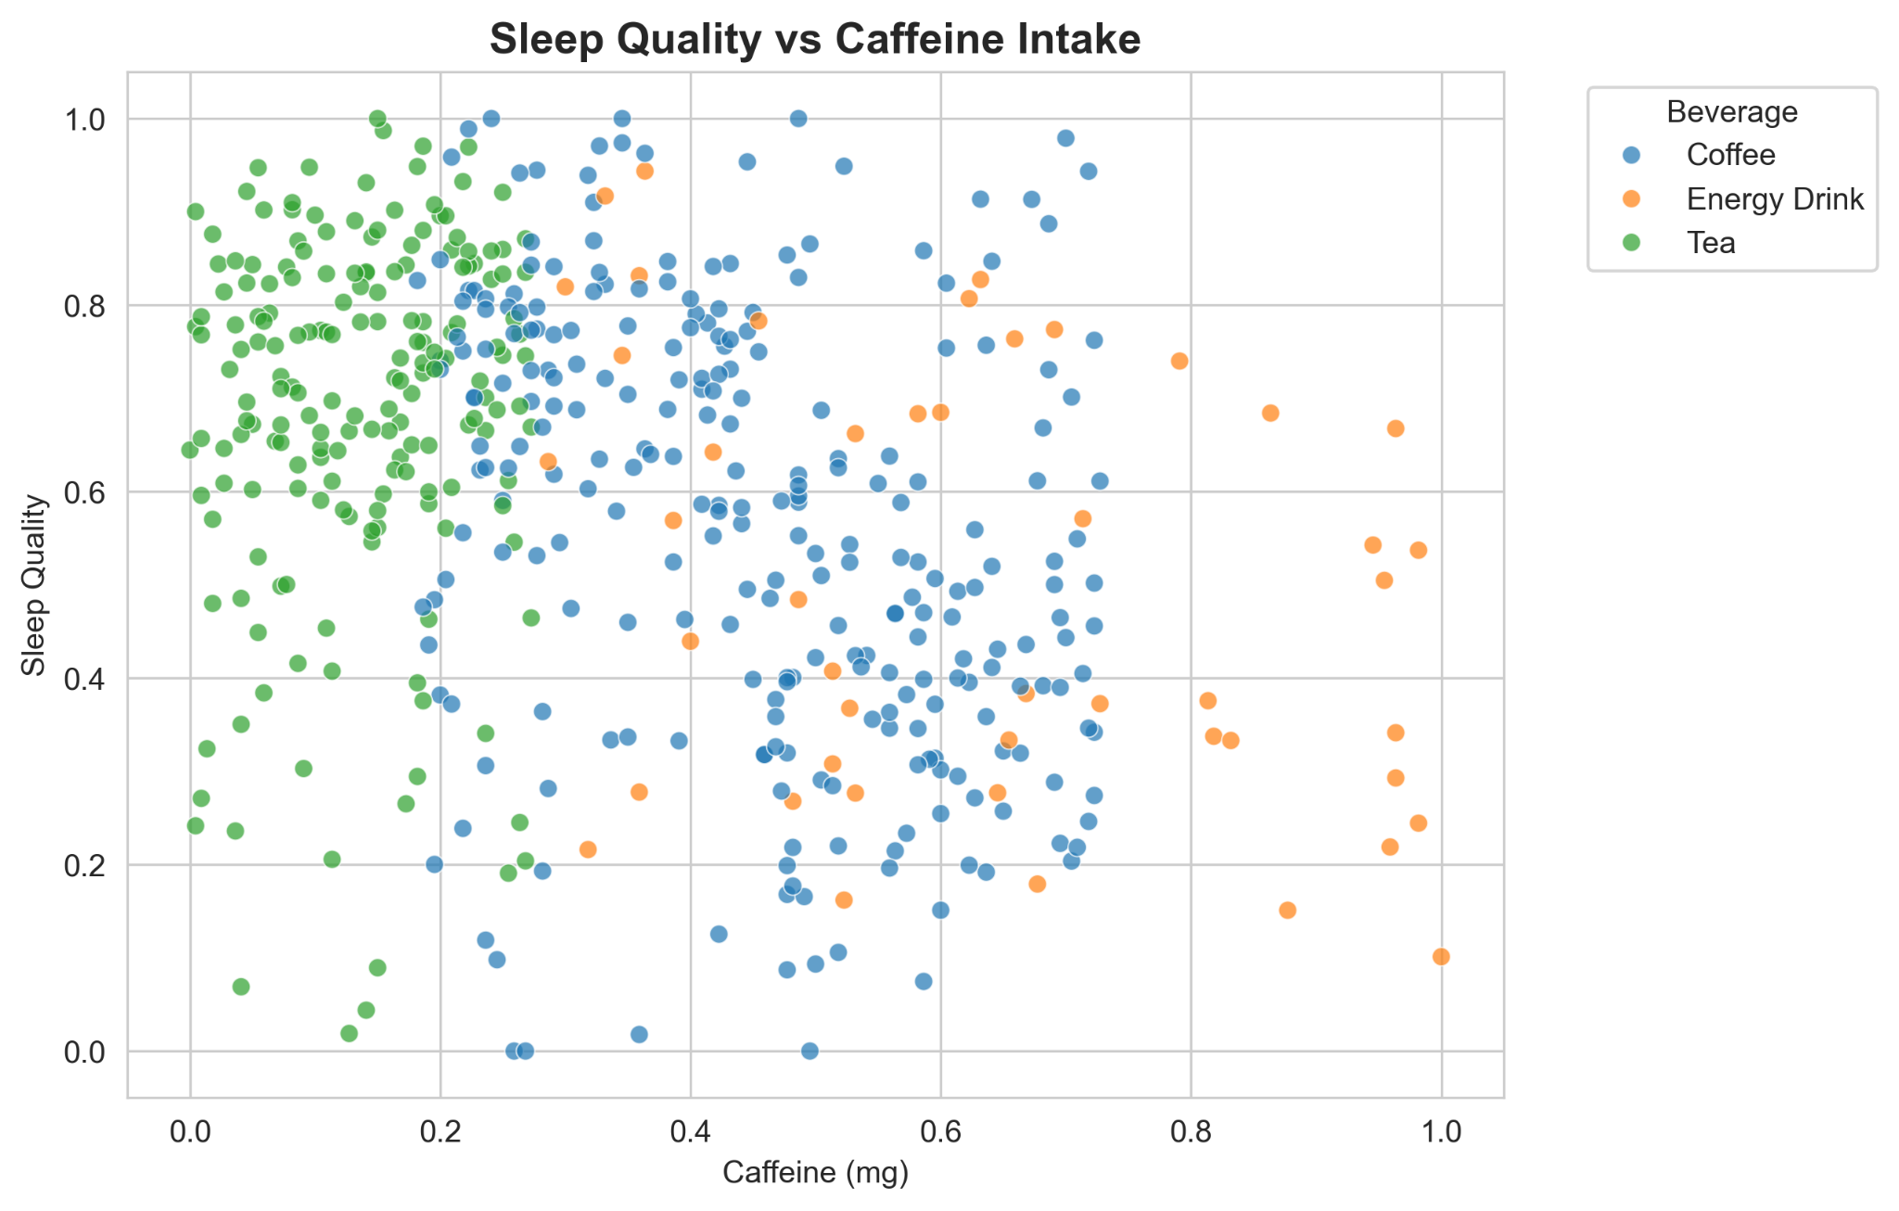
Sleep Quality vs. Caffeine Intake
Scatterplot
X axis = Caffeine (in milligrams)
Y axis = Sleep quality (scale of 0-1)

Slide 14
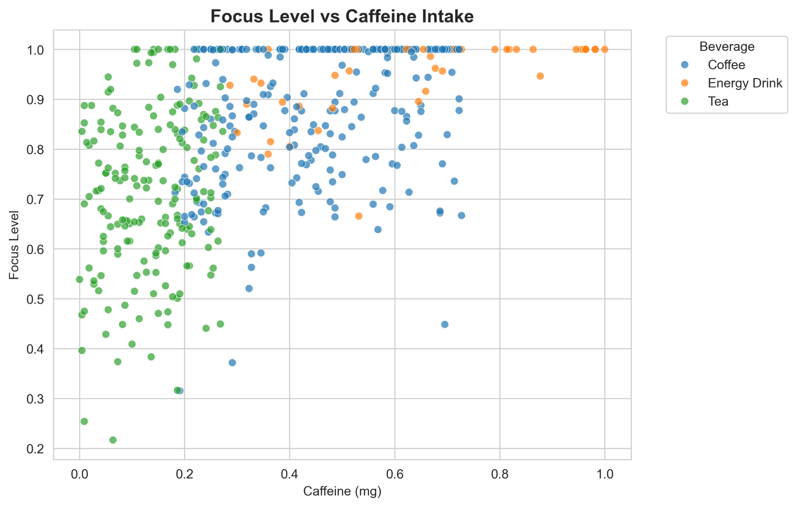
Focus Level vs. Caffeine Intake
Scatterplot
X axis = Caffeine (in milligrams)
Y axis = Focus Level (scale of 0-1)

Slide 15
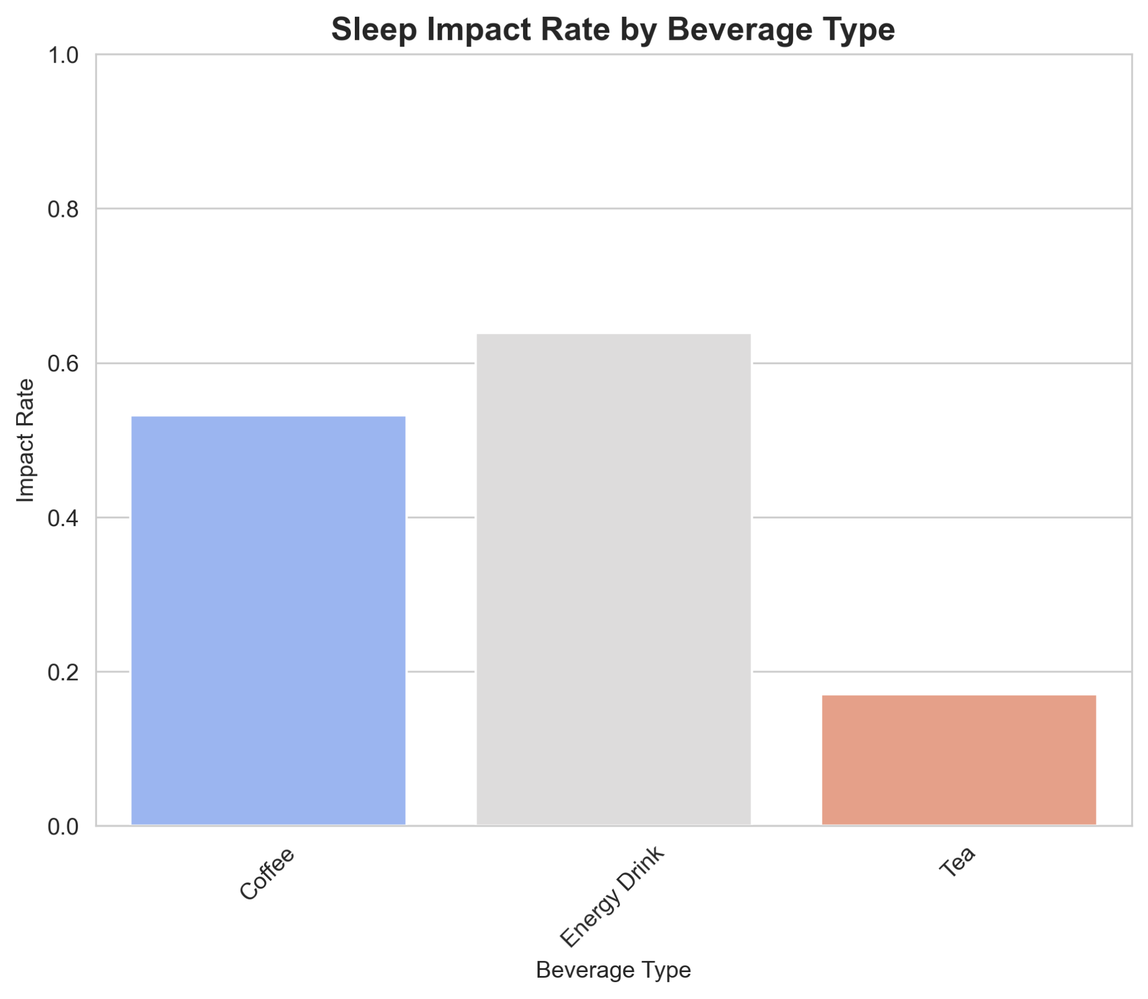
Sleep Impact by Beverage Type
Bar chart
X axis = Beverage Type
Y axis = Impact Rate (scale of 0-1)

Slide 16
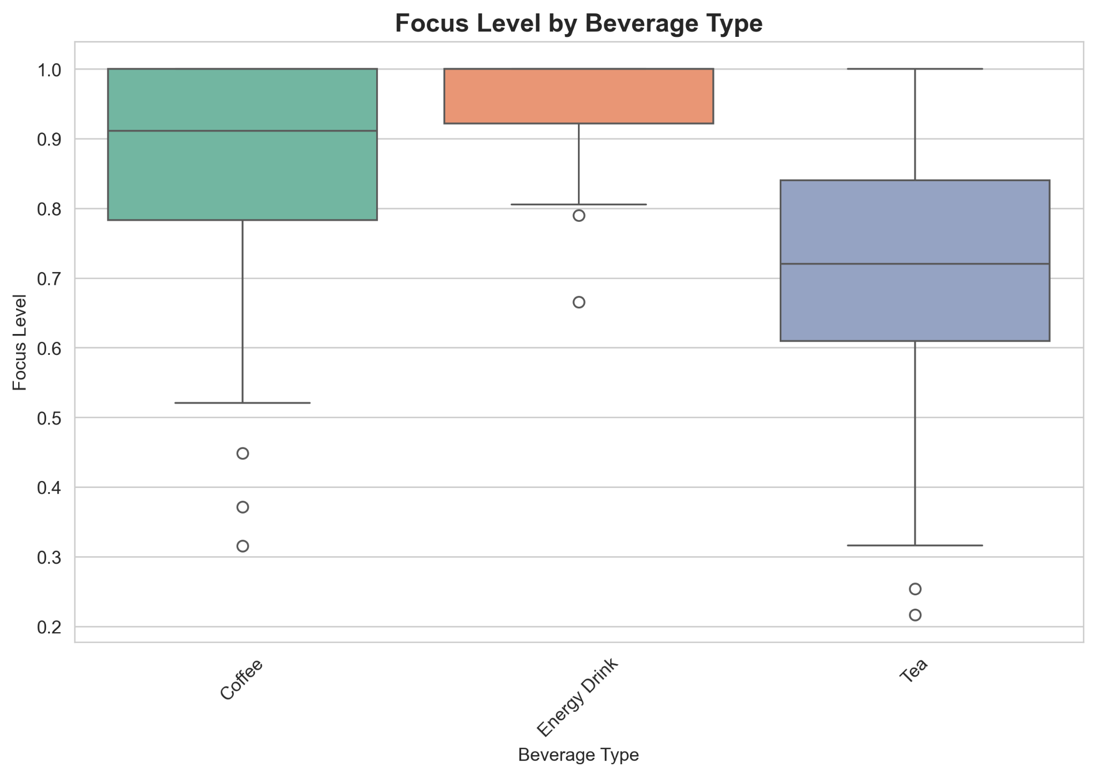
Focus Level by Beverage Type
Box plot
X axis = Beverage Type
Y axis = Focus Level (scale of 0-1)

Slide 17
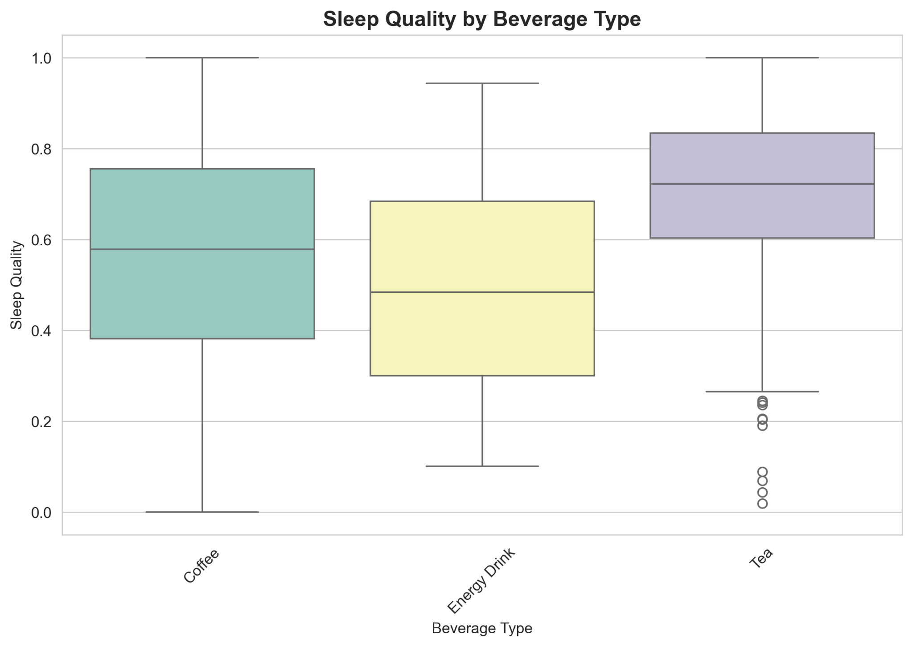
Sleep Quality by Beverage Type
Box plot
X axis = Beverage Type
Y axis = Sleep quality (scale of 0-1)

Slide 18
Graph Interpretations
Energy drink users tend to cluster at lower sleep quality scores
Coffee has the widest spread of focus levels
Tea appears to have the least negative impact on sleep

Slide 19
Modeling & Analysis

Slide 20
Models
Logistic Regression
Fast and interpretable
Good for understanding feature impact
Suitable for binary classification (sleep impacted: yes/no)
Random Forest
Captures complex interactions between features
Provides feature importance rankings
Less prone to overfitting

Slide 21
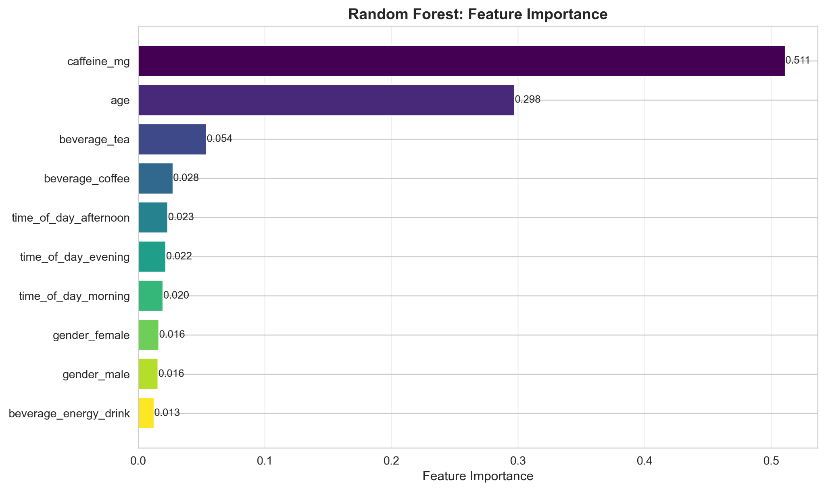
Random Forest: Feature Importance
Bar chart ranking feature importance from Random Forest
Top Findings:
  Caffeine (mg): 51.12% - Dominant predictor (as expected)
  Age: 29.75% - Second most important
  Beverage type: Tea (5.4%), Coffee (2.8%), Energy (1.3%)
  Time of day & Gender: <2% combined importance

Slide 22
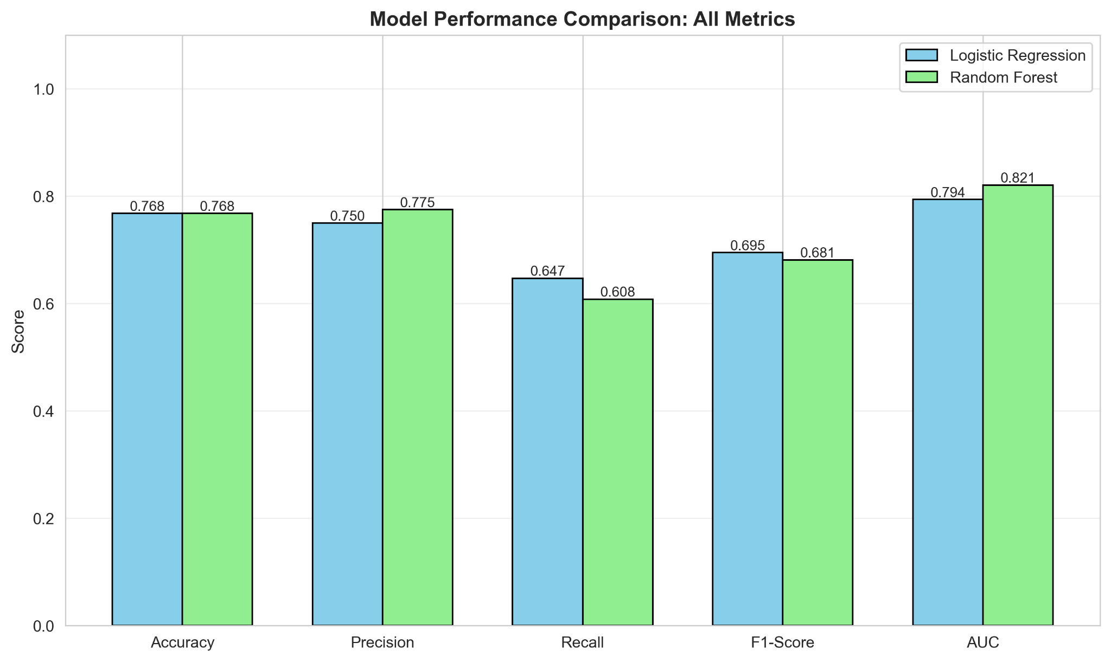
Model Performance Comparison: All Metrics
Side-by-side confusion matrices for both models
Interpretation:
  Logistic Regression: 63 TN, 11 FP, 18 FN, 33 TP
  Random Forest: 65 TN, 9 FP, 20 FN, 31 TP
  RF has fewer false positives, better at identifying true negatives

Slide 23
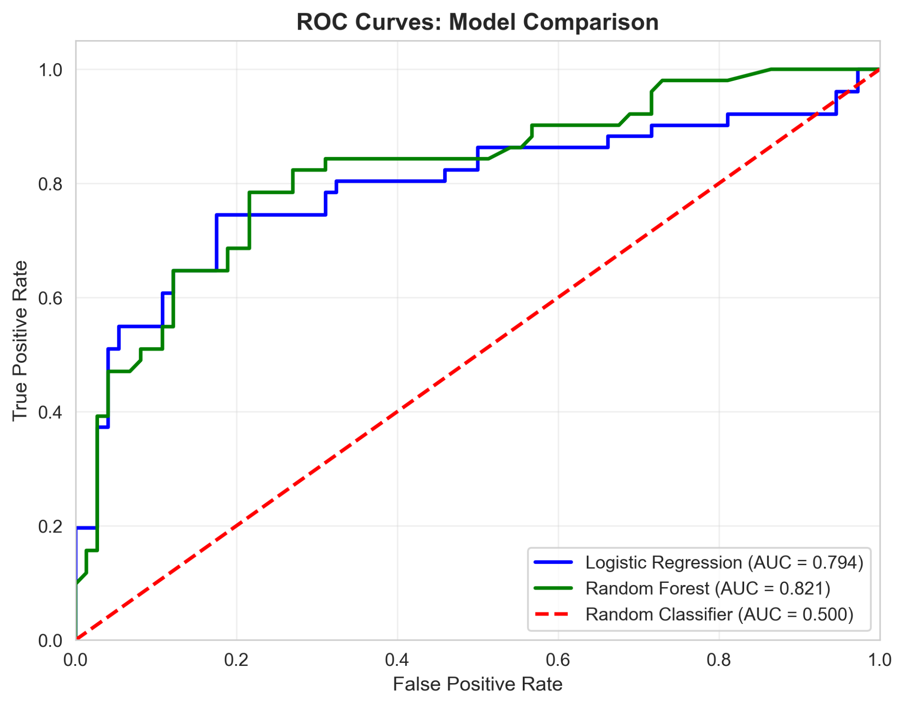
ROC Curves
ROC curves comparing both models
Interpretation:
  Logistic Regression AUC: 0.7939
  Random Forest AUC: 0.8207
  RF's higher AUC indicates superior ability to distinguish between sleep impact and no impact

Slide 24
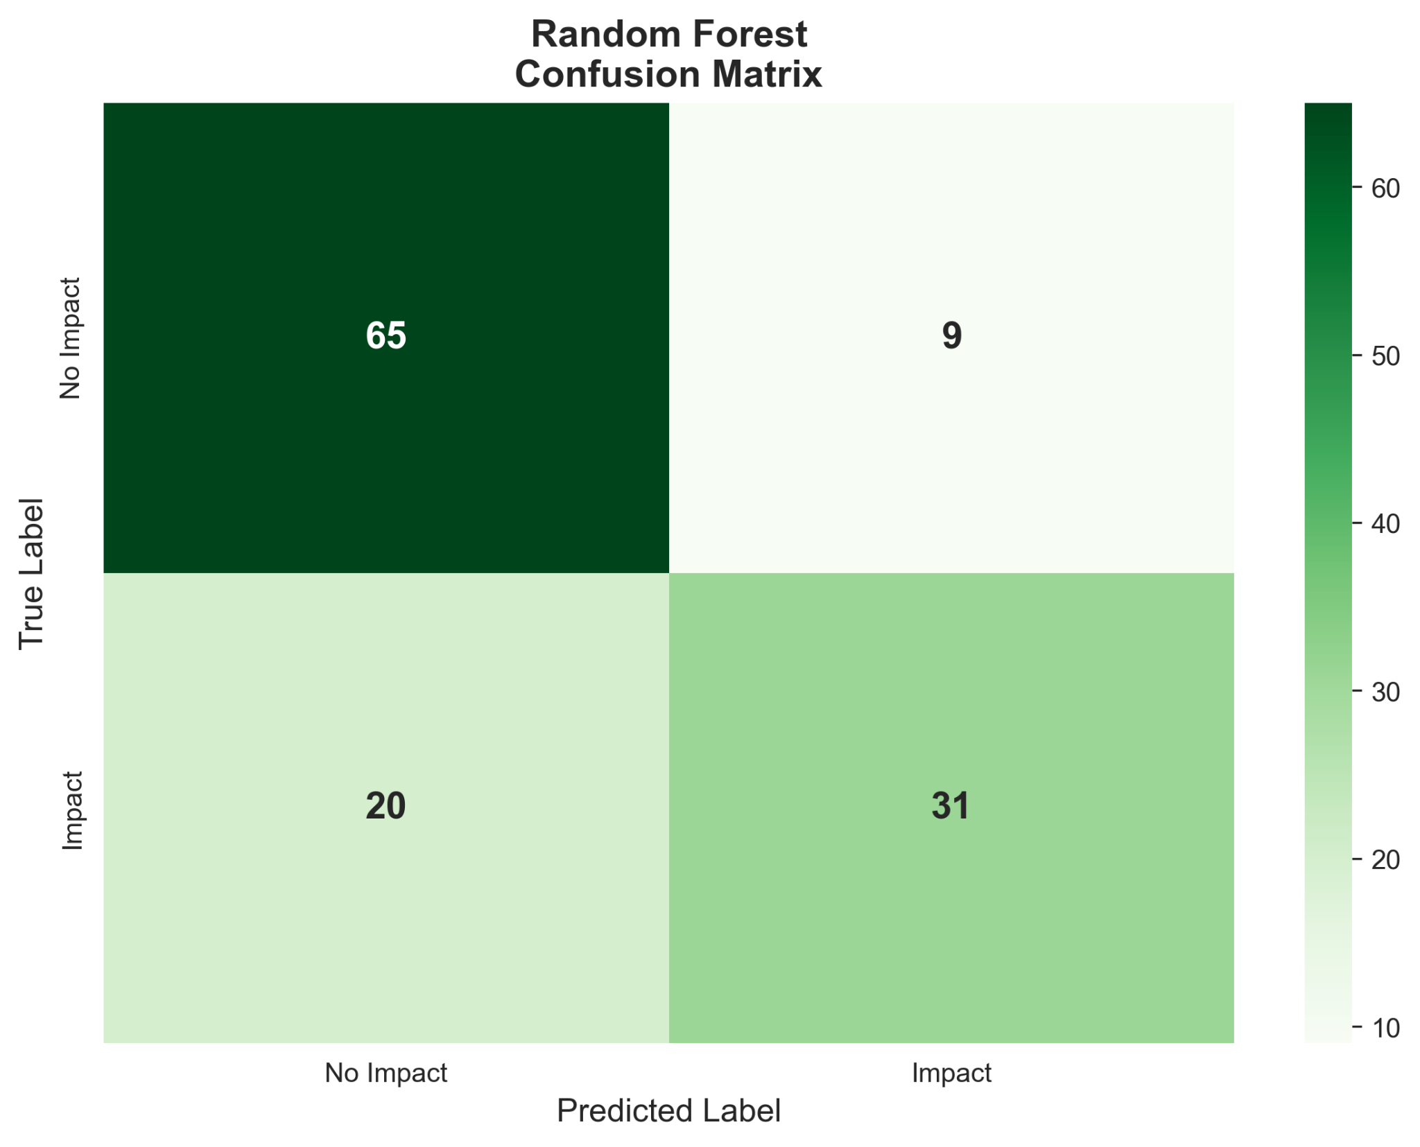
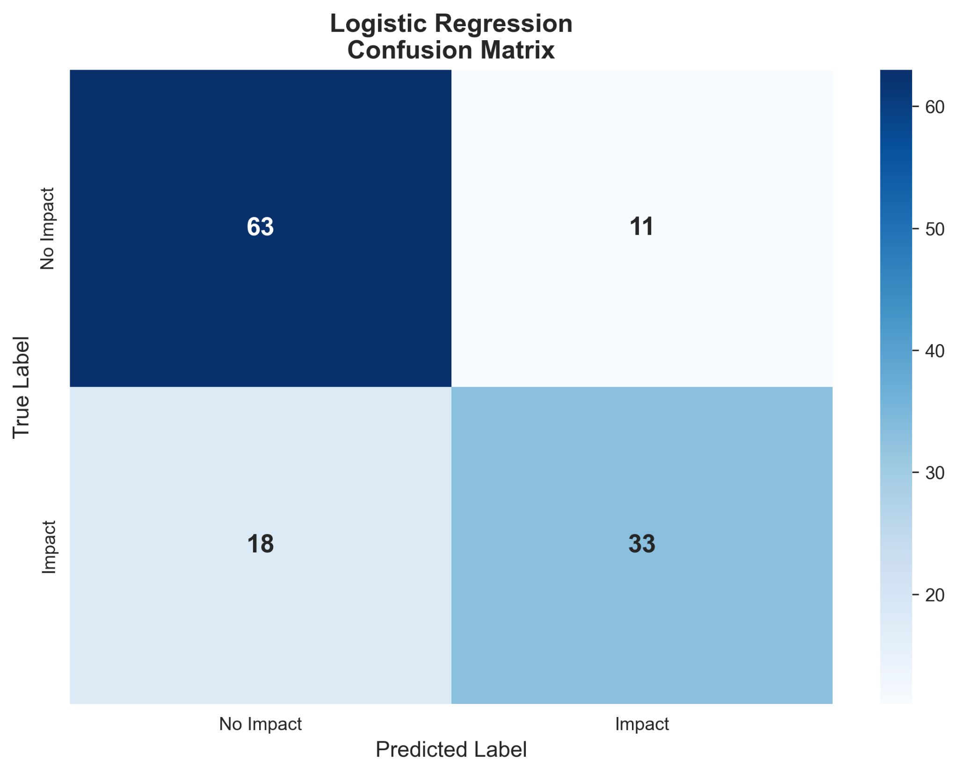
Confusion Matrix
Bar chart comparing 5 metrics (Accuracy, Precision, Recall, F1, AUC)
Key Metrics | Logistic Regression | Random Forest
Accuracy | 76.80% | 76.80%
Precision | 75.00% | 77.50%
Recall | 64.71% | 60.78%
F1-Score | 69.47% | 68.13%
AUC | 79.39% | 82.07%

Slide 25
Best Model?
Random Forest
Superior AUC (0.8207 vs 0.7939)
  Better overall discrimination
Higher precision (77.5% vs 75%)
  Fewer false positives
Captures non-linear caffeine-sleep relationships
Feature importance reveals caffeine is the dominant factor (51%)
  Confirms our hypothesis
Most Important Predictive Factors
  Caffeine mg
  Evening consumption
  Energy drink consumption
  Coffee consumption

Slide 26
Discussion & Conclusion

Slide 27
Hypothesis Evaluation
Supported?
Sleep Impact Rate
Focus
Sleep Quality
Coffee and energy drinks showed higher average focus than tea
Tea drinkers reported higher sleep quality than coffee/energy drinks
Energy drinks strongly impacted sleep, but coffee impact was not significantly higher than tea in all cases
YES
YES
NO

Slide 28
Conclusions
Coffee and energy drinks do improve focus more than tea.
Caffeine amount and time of day significantly influence sleep impact
01
04
Tea is consistently associated with better sleep outcomes
02
A Random Forest model can reasonably predict sleep disruption
05
Energy drinks carry the highest risk of sleep disruption
03

Slide 29
Limitations
Dataset size is limited (n = 500)
Self-reported metrics introduce subjective bias
One-hot beverage data limits nuance (e.g., no dosage or brand type)

Slide 30
Future Work
Expand dataset with more daily logs
Explore clustering to identify caffeine-use behavior segments
Build a Streamlit dashboard
Daily caffeine intake logs over weeks
Include physiological measures like heart rate or sleep-tracker data

Slide 31
Thank You!
Q&A

